Slide 1
Attentional bias between light and heavy drinking college students
Manuel Moreno¹, Alexandra Ghita^{2*} & José Gutiérrez-Maldonado²
¹Department of Cognition, Development and Education Psychology, University of Barcelona
² Department of Clinical Psychology and Psychobiology, University of Barcelona

Slide 2
Content
1. Introduction
2. Objectives of the study
3. Method
4. Results
5. Conclusions
6. Future research directions
Notes:
First, I am going to present you to the concept of attentional bias related to alcohol consumption, then I am going to proceed with the objectives of the study, method, results, what we concluded from this study and finally I am going to mention our future research directions.

Slide 3
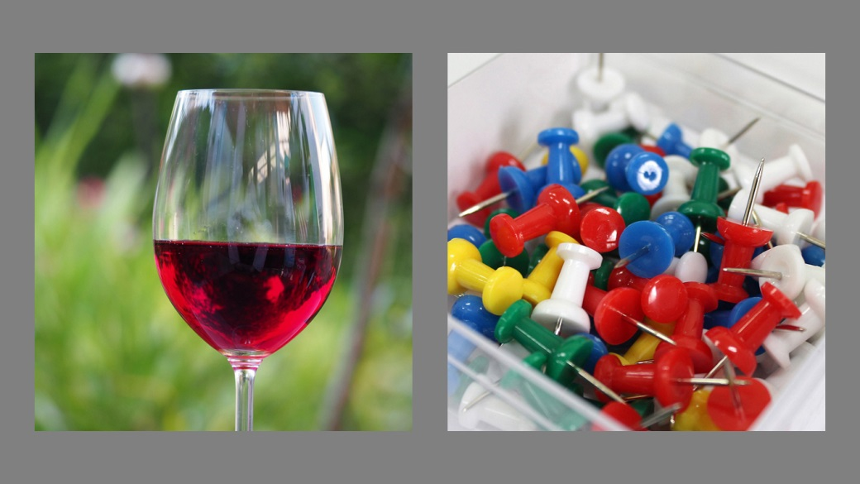
Introduction
Attentional bias and alcohol consumption
Notes:
In the context of alcohol consumption, prolonged exposure to alcohol-related cues facilitate a process called attentional bias. Attentional bias has been defined as an implicit selective attention of processing visual information in favor of alcohol-related stimuli.

Slide 4
Introduction
Attentional bias – alcohol craving
Notes:
Therefore, literature suggests that this implicit cognitive processing may elicit or trigger craving for alcohol. As you may know, craving is an intense desire or urge to drink alcohol. What is important to outline here is that this strong relationship between craving and attentional bias may further precipitate approach-behavioral tendencies that may results into episodes of alcohol abuse, especially among young adults.

Slide 5
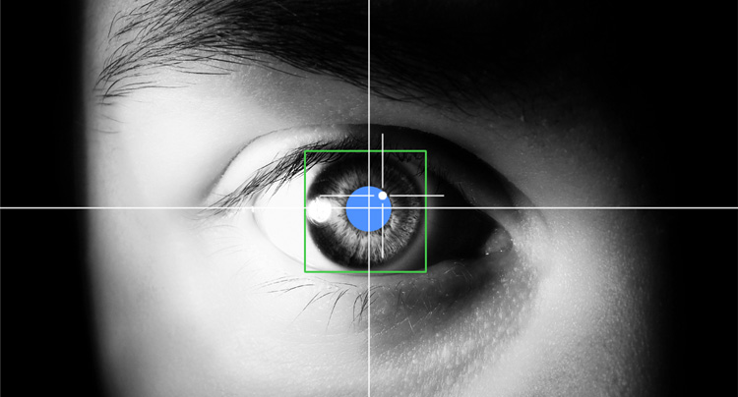
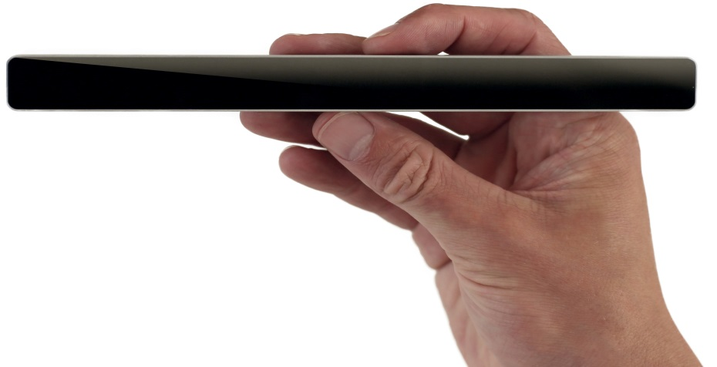
Introduction
Current research on Human-Computer Interaction (HCI)
Notes:
In the past years, the field of Human-Computer Interaction applied in psychology has drawn a lot of attention. In line with this, the eye-tracking technology can provide important data in terms of eye-movement activity regarding disorder-related stimuli, in particular in our study I am referring to alcohol-related stimuli and what changes in eye-movement activity when a person is exposed to alcohol stimuli.

Slide 6
2. Objectives of the study
Previous work - Christiansen, Mansfield, Duckworth, Field, & Jones (2015)
-> Visual Probe Task
Cristiansen, P., Mansfield, R., Duckworth, J., Field, M., & Jones, A. (2015). Internal reliability of the alcohol-related visual probe task is increased by utilising personalised stimuli and eye-tracking. Drug and Alcohol Dependence, 155, 170–174. http://doi.org/10.1016/j.drugalcdep.2015.07.672
Notes:
Although there is limited research on applying the eye-tracking technology in assessing the severity of alcohol consumption, a study by Christiansen et al (2015) made important advances by implementing a visual probe task containing alcohol related stimuli relevant to the British context.

Slide 7
2. Objectives of the study
Primary objective - To create a visual attention task to explore attentional bias towards alcohol-related stimuli using the eye-tracking technology in Spanish drinking college students.
Secondary objectives – To explore whether eye movement data such as first gaze towards the cues, total dwell time and fixations can differentiate between light and heavy drinking college students.
Notes:
Following a similar experimental procedure, our primary objective was to create a visual attention task to assess attentional bias towards alcohol related images versus neutral images in Spanish college students. And, we were particularly interested in exploring the first gaze a participant had towards the images, the total dwell time (which is defined as the total time a participant had spent of observing a cue) and fixations (small dots on the area of interest) as you will further see. If these variables can differentiate between light and heavy drinking cases.

Slide 8
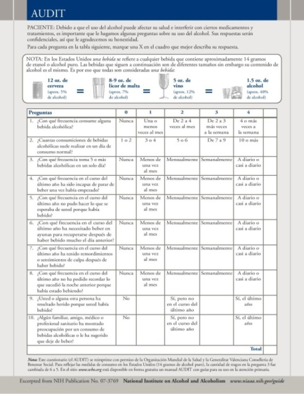
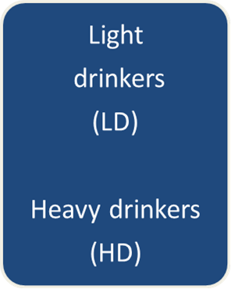
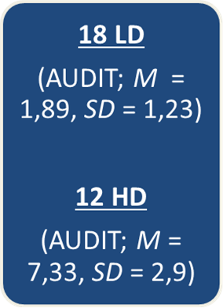
3. Method
Participants - N = 30, M = 22 yrs (SD = 4.29)
Cut-off score – Alcohol Use Disorder Identification Test
(AUDIT; 7 for men and 5 for women)
Gual, A., & Colom, J. (2005). Identificación temprana del bebedor de riesgo. Medicina Clínica, 125(19), 734–735. http://doi.org/10.1016/S0025-7753(05)72172-2
Notes:
30 spanish college students participated in this study on basis of their informed consent. The cut off score to divide the participants was the score of the AUDIT. Therefore, those who scored higher than 7 for men and 5 for women were heavy drinking college students and those who scored less were light drinking college students. Therefore, we had 18 light drinkers and 12 heavy drinkers.

Slide 9
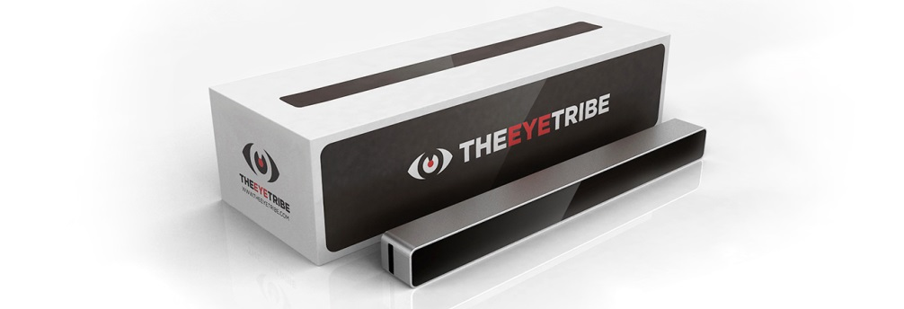
3. Method
Apparatus
The eye-tracking technology
The EyeTribe
Notes:
As for the technology we used, we used the EyeTribe eye-tracking apparatus, which is a stable eye-tracker, easy-to-use.
*not available on the market anymore

Slide 10
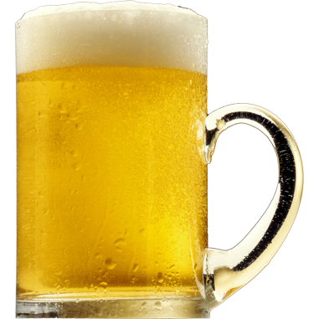
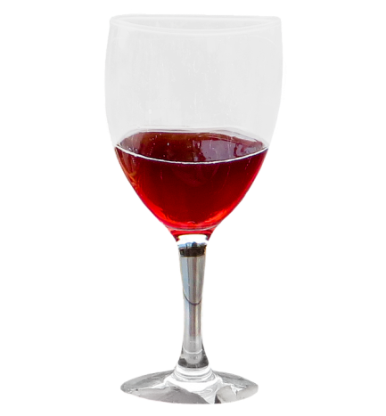
3. Method
Stimuli - Neutral and alcohol-related images
Spanish National Survey on Alcohol Consumption (2011-2012) (“Encuesta Nacional de Salud 2011/12. Consumo de alcohol)
1
2
3
Notes:
Regarding the alcohol cues, the images were selected based on the Spanish National Survey on Alcohol Consumption, where beer was the most consumed alcoholic beverage, followed by wine and whisky and liquors.

Slide 11
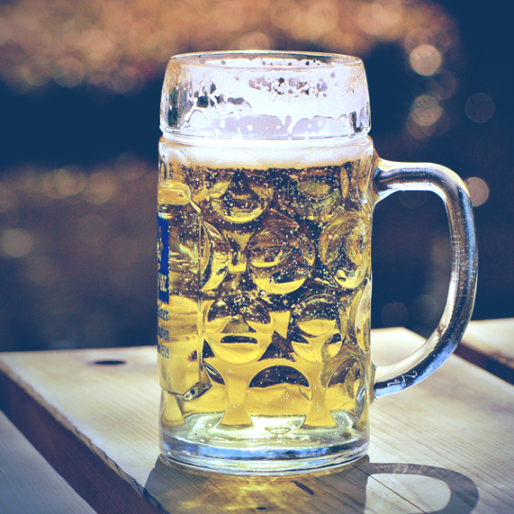
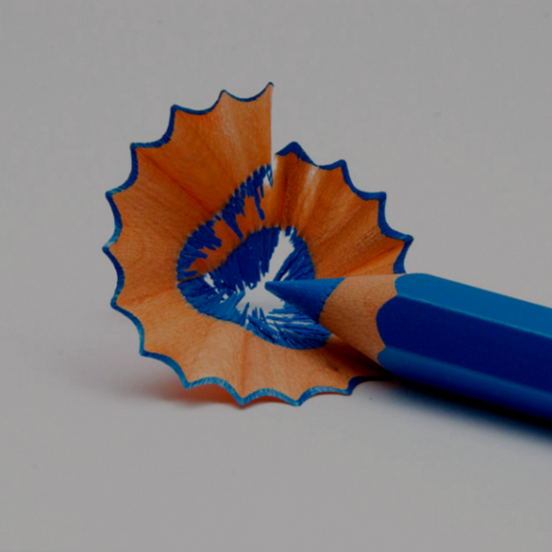
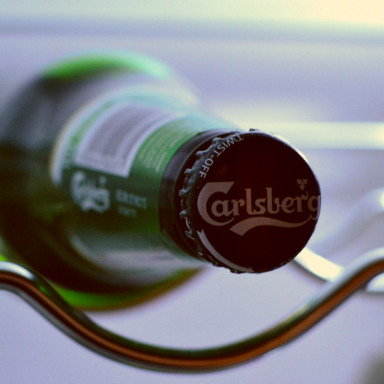
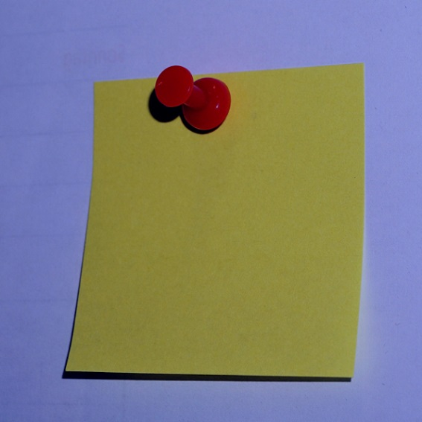
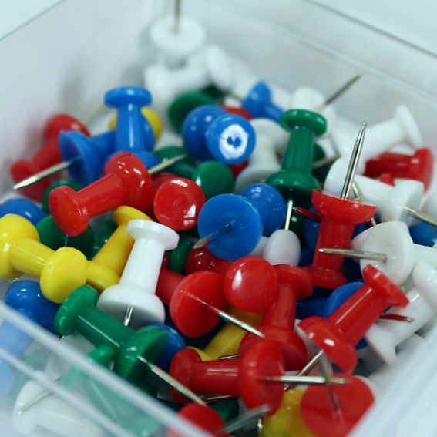
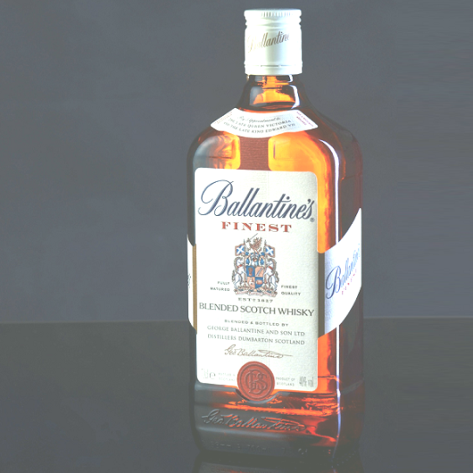
3. Method
Stimuli - Neutral and alcohol-related images
Spanish National Survey on Alcohol Consumption (2011-2012) (“Encuesta Nacional de Salud 2011/12. Consumo de alcohol)
Notes:
These are a couple of images of alcohol-related stimuli. Regarding the netral images, we followed the procedure of a Study by Field at the University of Liverpool and we used office-related objects as neutral images. Pencils, pinpoints

Slide 12
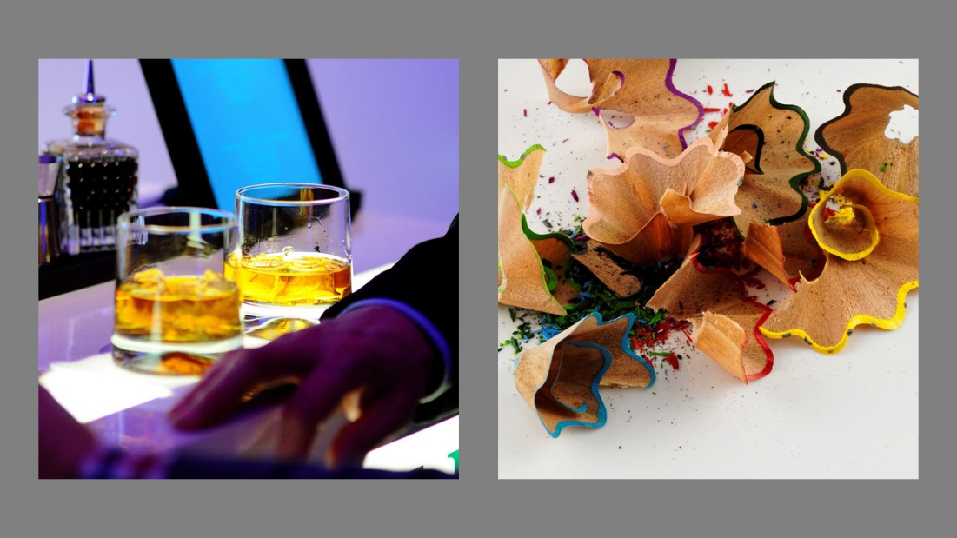
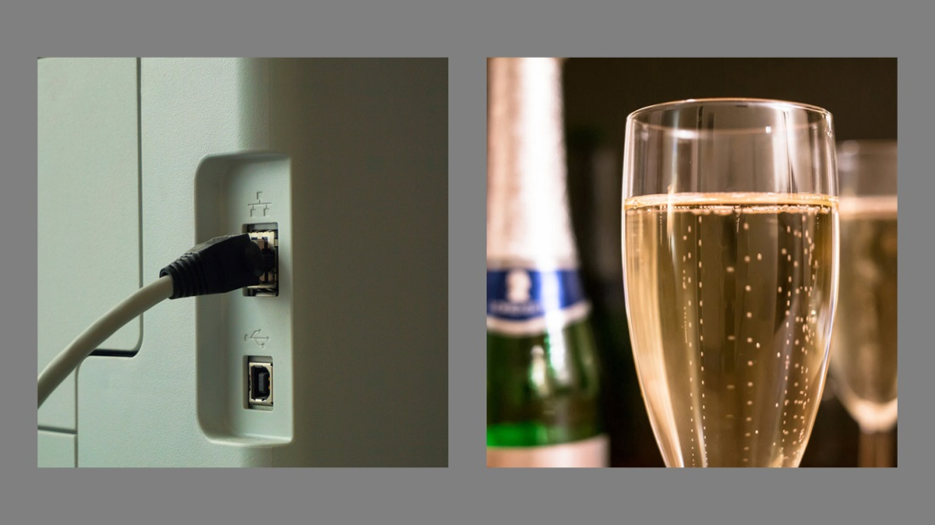
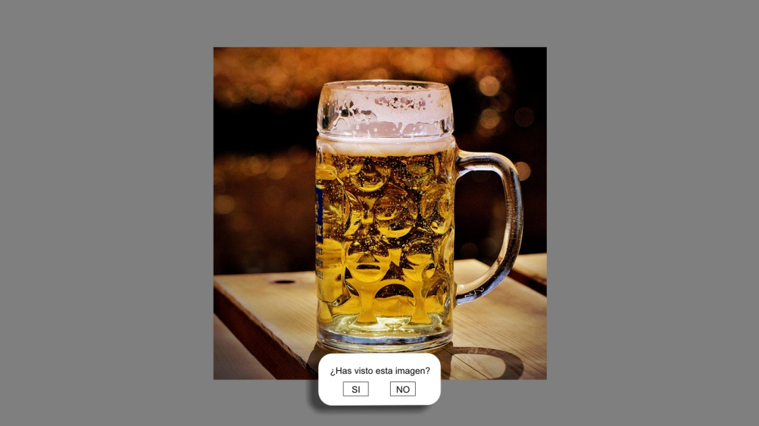
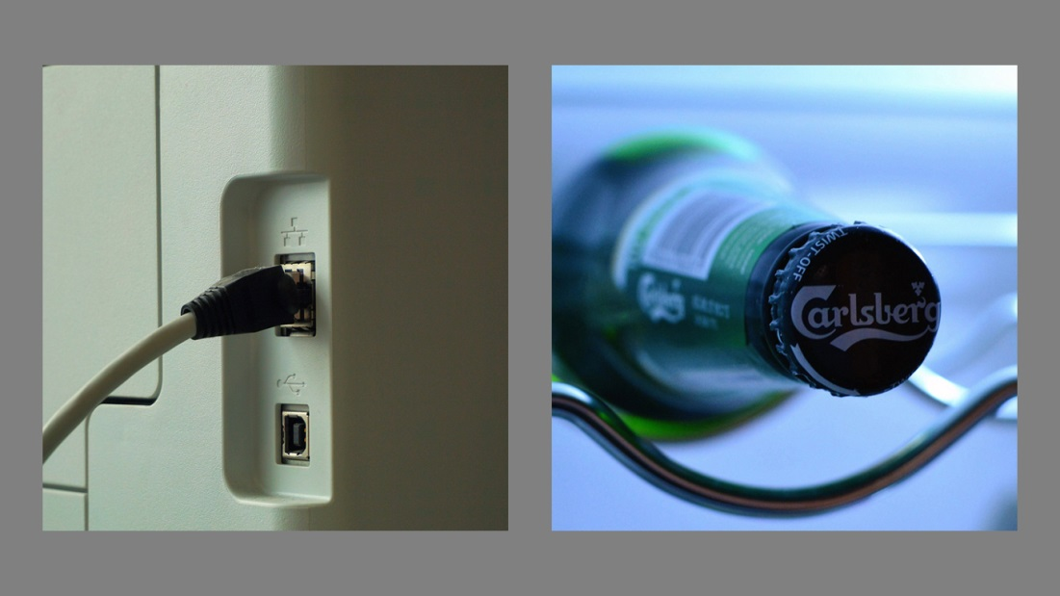
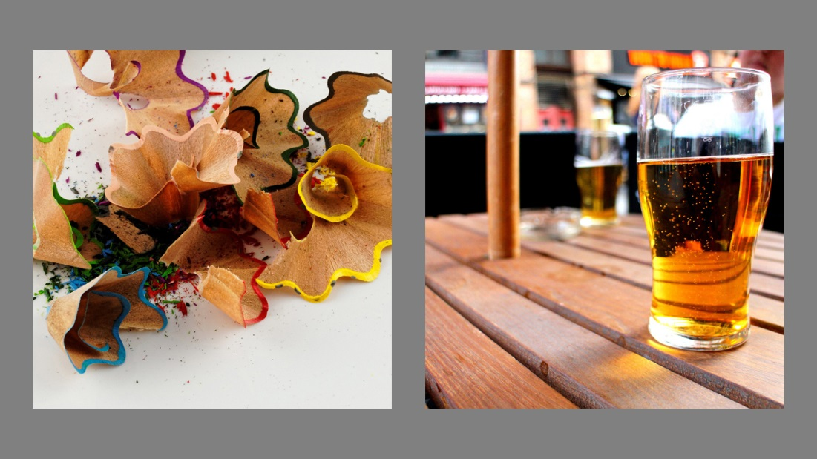
3. Method
Instruments – AUDIT + Visual Attention Task (VAT)
Notes:
The task participants had to complete, the VAT (visual attention task) consisted of 28 trials (10 pairs of images per trial) of 12 alcohol-related images versus 12 neutral images as you can see here in the slideshow. All pairs of images were counterbalanced and were exposed on the screen for 3 seconds. After each trial, participants were asked to report whether they saw or not a certain image on the screen that belonged to the previously seen trial.

Slide 13
3. Method – Procedure
Notes:
I am going to show you a 3 second sequence in slow-motion and you can see the yellow dots

Slide 14
3. Method – Procedure
Notes:
And this is the recording part of the eye-movement activity during the experiment. As you can see, we used a chin-rest to avoid head movements and have more accurate data.

Slide 15
4. Results
Dwell time
 | Alcohol | Neutral
LD | 51.2426052 | 48.7573948
HD | 49.2715111 | 50.7284889
Notes:
What we did here was to calculate the total time or the fixation time of each alcohol-related or neutral image and compare their percentages. As you can see, there were no significant differences between HD and LD regarding the dwell time, the total time exploring the images. Both groups explored similarly the alcohol-related and neutral images.

Slide 16
4. Results
b. Fixations
 | Alcohol | Neutral
LD | 49.8095946 | 50.1904054
HD | 51.143699 | 48.856301
Notes:
We determined the total number of fixations (small dots you saw ealier) of each alcohol related image and neutral images. Although we did not obtain a stastiically significant result, it is noteworthy to mention the difference between LD and HD. HD had more fixations exploring alcohol-related images compared to LD who had the tendency to explore more neutral images.

Slide 17
4. Results
c. First gaze
*
 | Alcohol | Neutral
LD | 44.988345 | 53.962704
HD | 47.4888748 | 52.2568341
Notes:
And finally, we determined which image received the first gaze. And here we obtained significant results. As you can appreciate from the graph, there was a significant difference between groups. HD had the tendency to first gaze at alcohol-related images compared to LD.

Slide 18
5. Conclusions
* First gaze may be an important variable to differentiate between light and heavy drinking college students.
* As an assessment instrument, the eye-tracking technology can provide significant data in terms of eye-movement activity.
* This is important because the eye-tracking technology can used to complement existing instruments in prevention programs targeting young adults.
Notes:
And because it can detect heavy drinking cases, it may be used to complement existing instruments in prevention programs targeting adolescents and young adults.
This is important because the eye-tracking technology can be implemented as a complementary tool among the existing instruments particularly in prevention programs targeting young adults.

Slide 19
Limitations…
Sample!
Notes:
More research

Slide 20
6. Future research directions
Implementation of the eye-tracking technology as an assessment instrument in patients diagnosed with Alcohol Use Disorder.

Slide 21
Thank you for your attention!
Acknowledgments. This study was supported by the Spanish Ministry of “Sanidad, Servicios Sociales e Igualdad. Delegación del Gobierno para el Plan Nacional sobre Drogas” (FEDER/UE/Project 2016I078: „ALCO-VR. Protocolo basado en realidad virtual para el tratamiento de pacientes con trastorno por uso de alcohol severo‟).

